Slide 1
DATA VISUALISATION
Continued by: Udit Gupta

Slide 2
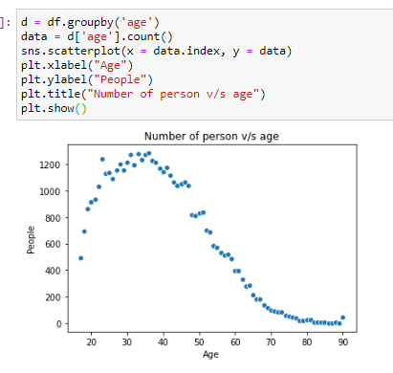
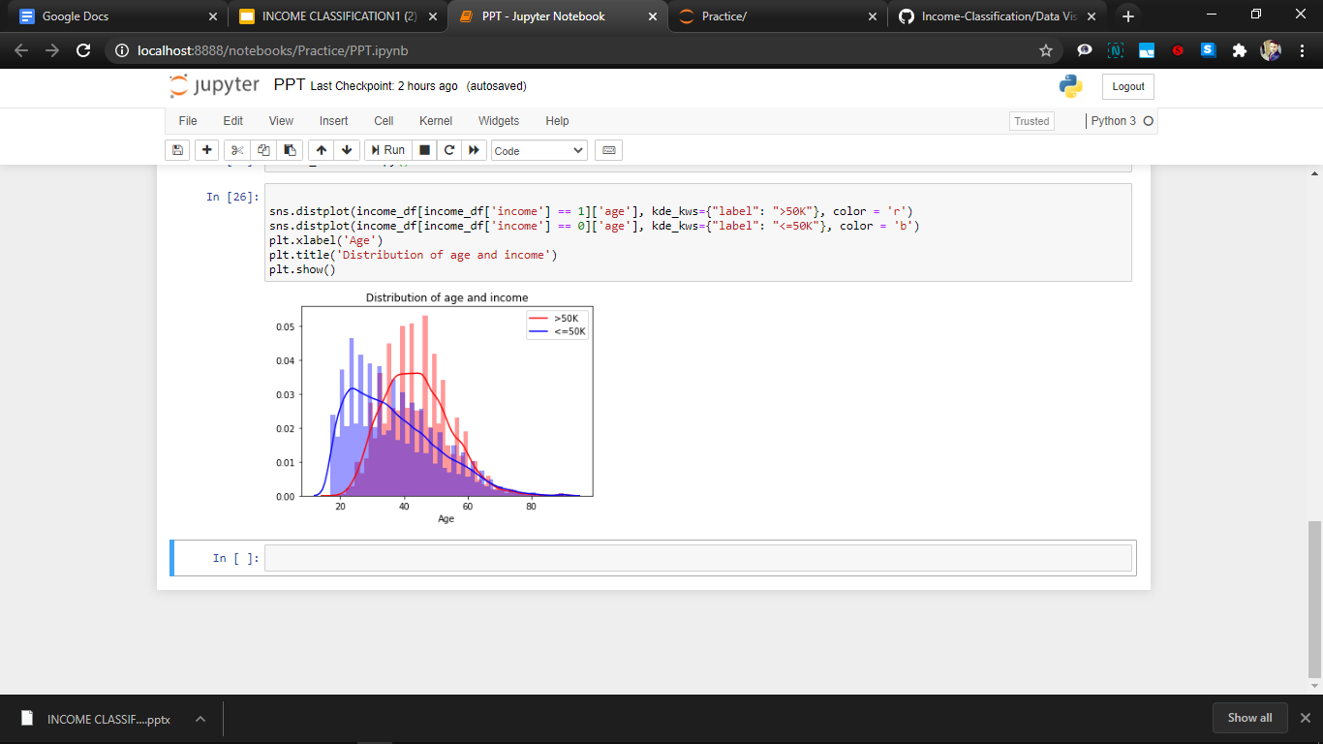
Age:
The plot shows that maximum people who have an income >50k belong to the age group 40 to 50 years.
Another thing to note is that people tend to have a lower income in early age but then gradually increase their income to above 50k in around 45 years of age.
The upper limit of age is 90 years and the lower limit is 17 years.
The dataset contains maximum people in the age group 25- 40 years.

Slide 3

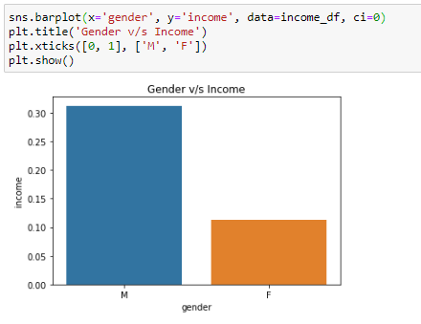
Gender:
The above donut chart shows that the total male entries is more than double of the total female entries in our dataset.
The percentage of male who earn above 50k is double than that of women.

Slide 4
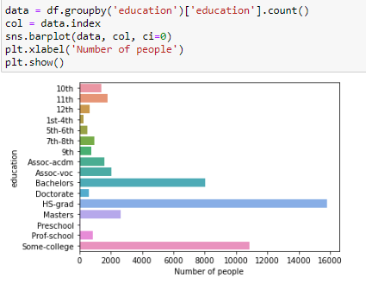
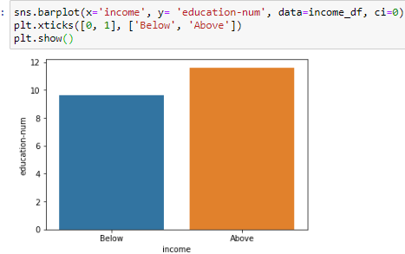
Education:
Majority of people have passed high school in the dataset or have a degree preferably Bachelors from some college.
This shows that if a person crosses high school and opt for a diploma or degree from a college, they have a better chance of getting higher income.
Avg education num :
Below - 10, Above - 12

Slide 5
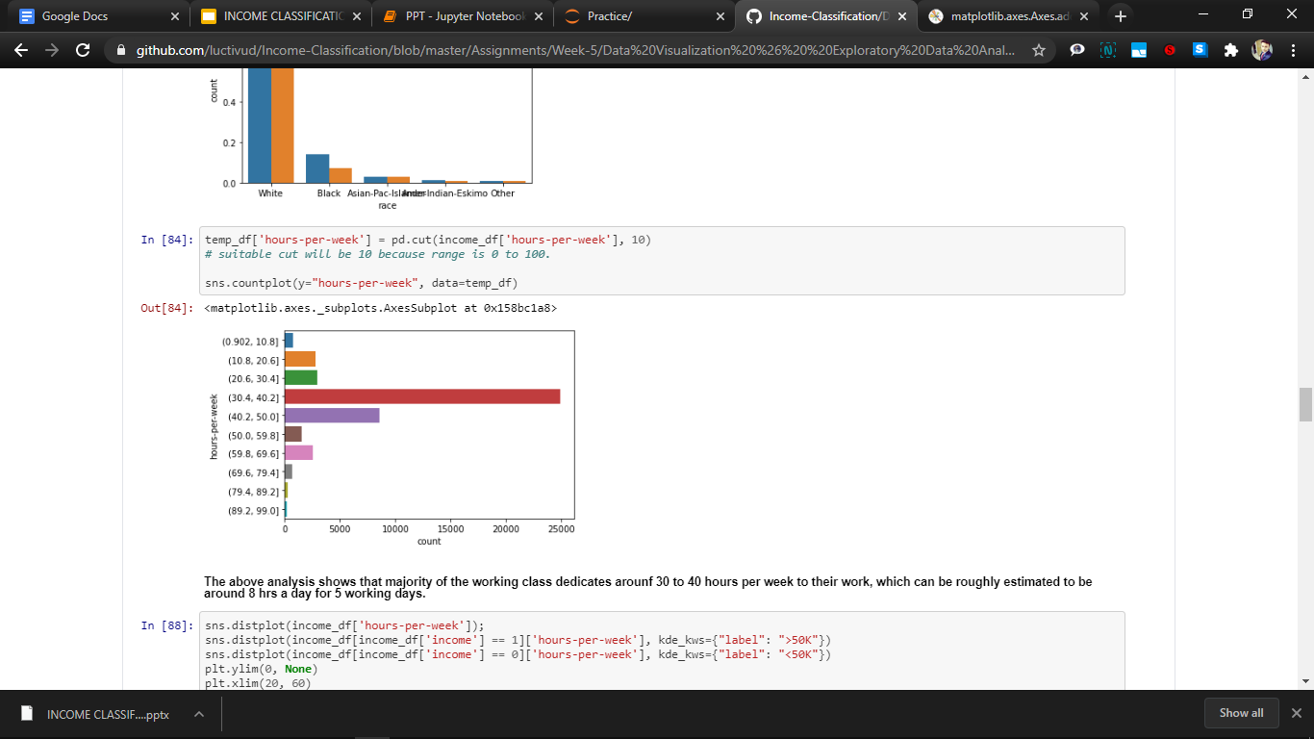
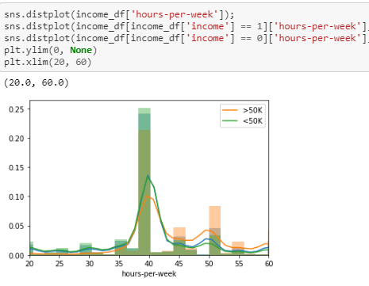
Hour per week:
The majority class works for 40 hours in a week which is around 8 hours for a working day.
There is a certain outlining value of 90 hours a week.
The maximal and optimal hours of working is hence 35 to 45 hours in the dataset giving out maximum high earners.

Slide 6

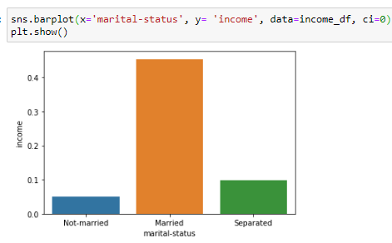
Marital Status:
The dataset has weightage of married and unmarried people in the society, with less than half of their cumulative sum of people being seperated.
Although the unmarried ones holds a majority in the population but still they don’t earn as much as the other groups, dominated by the married people.

Slide 7
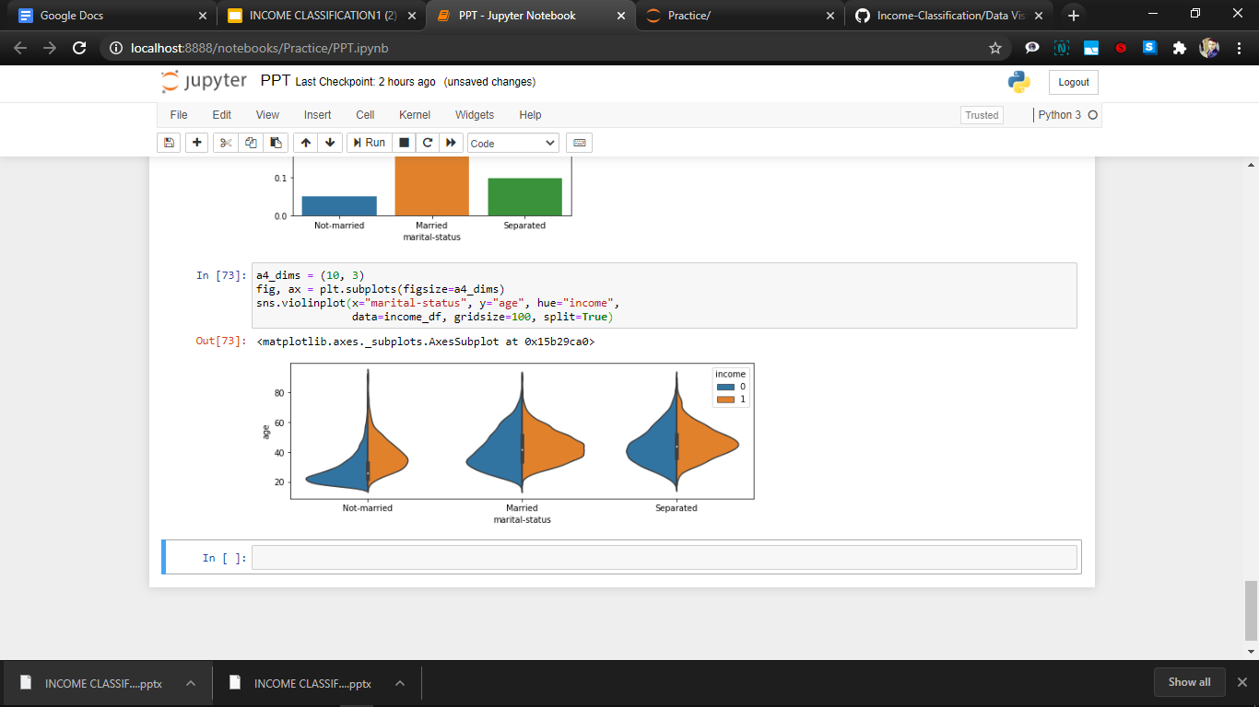
Marital Status vs Age
This shows that married as well as separated share the same relation in age.
Why unmarried earn less despite constituting a majority?
As shown by the plot, it is quite clear that the unmarried people are around the age of 20-40.
And due to our previous analysis it is shown that optimal age for big earning is above 40 years, and after that age almost everyone is married, hence unmarried tends to earn less by virtue of their age group.

Slide 8
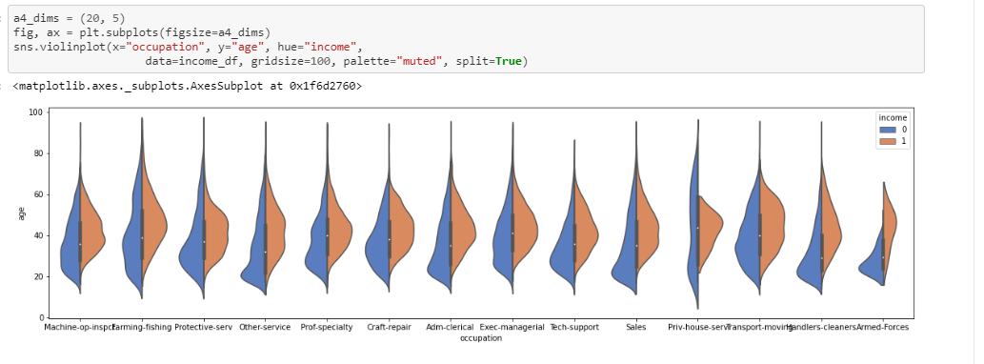
Occupation v/s Age:
Plot the Occupation vs Age graph on the basis of the income as base line.
The general trend is that more senior workers have higher salaries.
Armed-forces don't have a high job salaries.
It is also evident that the private housing have most age variation but the income range for the variation is still nominal means there is not much income in it.

Slide 9
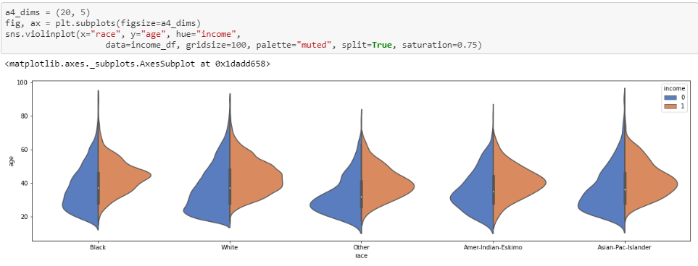
Race v/s Age over Income
It is seen from the above violin plot that the income distribution does rarely depend on the race of a person as the distribution as well width of the plot is identical in every aspect.
Although there is a certain decrease in the income of above 50k for black people and the american-indians have a uniformly scattered plot against age for above 50k.

Slide 10
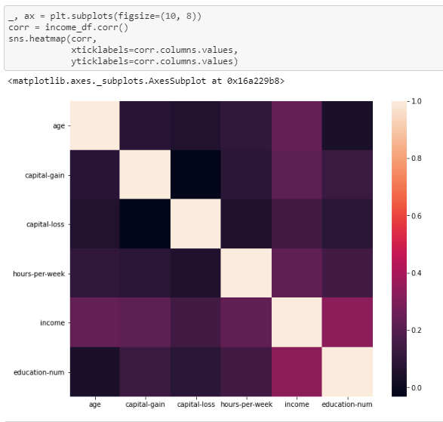
Correlation
Matrix
It is evident that the two most important factors for determining the income of a person are the age and education number.
Capital gain and loss also foresee the same as the person with higher gain can hit 50k early.
Hours per week also defines it with its optimal range of working hours & impacting the income distribution.

Slide 11
Thank You!

